Slide 1
Polymorphism
Course Code: CSC 2210
Course Title: Object Oriented Programming 2
Dept. of Computer Science
Faculty of Science and Technology
Lecturer No: | 05 | Week No: | 05 | Semester: | Fall 2023-2024
Lecturer: | Tonny Kar

Slide 2
Topics
Polymorphism
Method Overriding
Method Overloading

Slide 3
Polymorphism
Polymorphism originates from the greek word “polys” which means many, and “morphe” which means forms, or shapes.
Polymorphism is possible when classes share a common interface. For example, a Cat class and a Dog class may share a common interface through inheriting the Animal class.
To understand Polymorphism, we must take a look at how we instantiate objects.
Cat myCat = new Cat();
Here we declare the reference type Cat, the variable name myCat and instantiate a new Cat object by calling new Cat();

Slide 4

Polymorphism
When classes share a common interface, we can redefine the reference type of the objects we are creating. So our myCat definition can be changed to:
Animal myCat = new Cat();
For example, we can now create an Array of Animals that can contains Dog objects, Cat objects and any other subclass of Animal.
Animal[] animals = new Animal[2];
animals[0] = new Cat();
animals[1] = new Dog();
Polymorphism is a very powerful concept that improves code extensibility and modularity.

Slide 9
Types of Polymorphism
Compile Time
Run Time

Slide 10
Compile Time
In compile time polymorphism, the compiler identifies which method is being called at the compile time.
In C#, we achieve compile time polymorphism through 2 ways:
Method overloading
Operator overloading

Slide 11
Compile Time
C# Method Overloading
In a C# class, we can create methods with the same name in a class if they have:
different numbers of parameter
types of parameter

Slide 12
Compile Time
C# Method Overloading
void totalSum() {...}
void totalSum(int a) {...}
void totalSum(int a, int b) {...}
void totalSum(float a, float b) {...}

Slide 13
Compile Time
C# Operator Overloading
Some operators in C# behave differently with different operands. For example, + operator is overloaded to perform numeric addition as well as string concatenation and
The + operator is used to add two entities. However, in C#, the + operator performs two operations:

Slide 14
Compile Time
C# Operator Overloading
1. int x = 7;
int y = 5;
int sum = x + y;
Console.WriteLine(sum); // Output: 12
2. string firstString = "Harry";
string secondString = "Styles";
string concatenatedString = firstString + secondString; Console.WriteLine(concatenatedString); // Output: HarryStyles

Slide 15
Run Time
In runtime polymorphism, the method that is called is determined at the runtime not at compile time.
The runtime polymorphism is achieved by:
Method Overriding

Slide 16
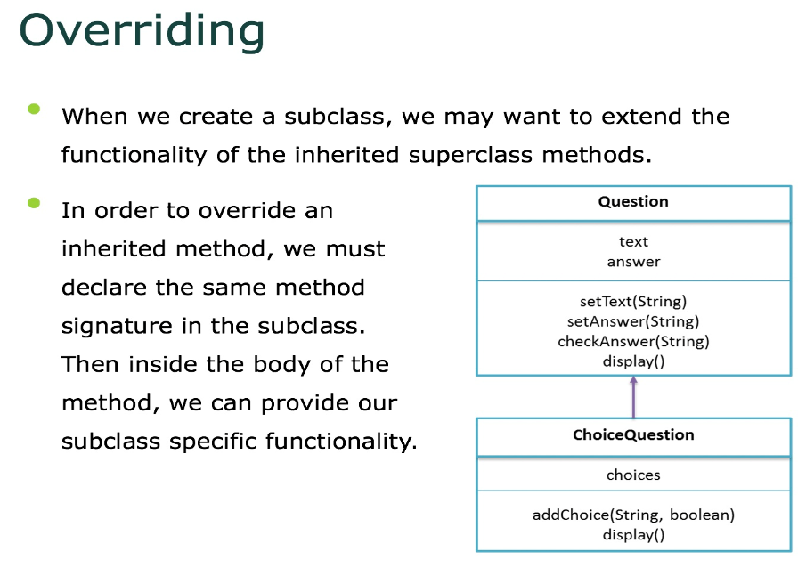

Slide 17
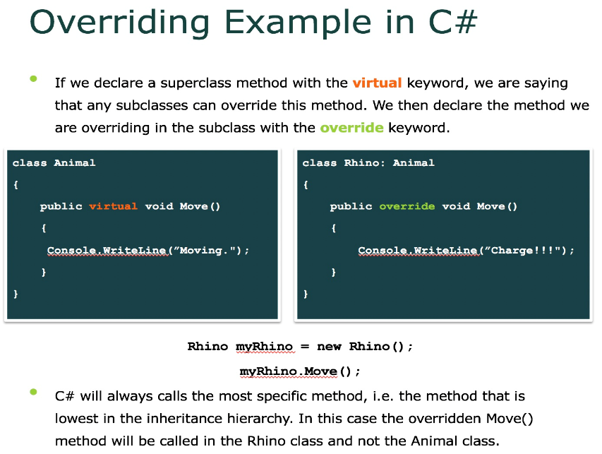

Slide 18
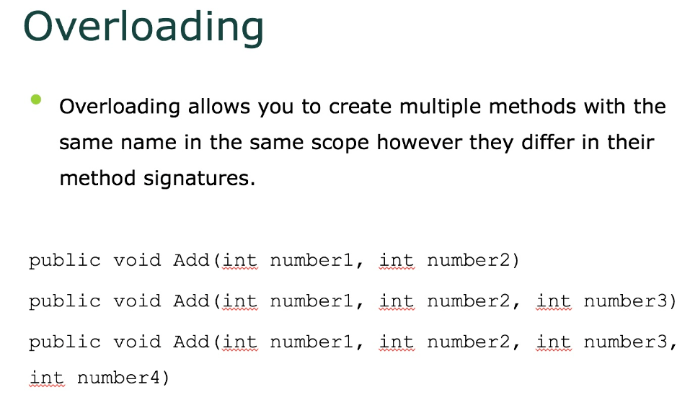

Slide 19
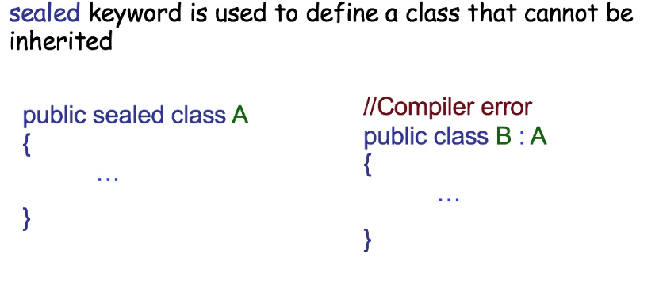
Sealed keyword

Slide 20

Thank You

Slide 21
Books
C# 4.0 The Complete Reference; Herbert Schildt; McGraw-Hill Osborne Media; 2010
Head First C# by Andrew Stellman
Fundamentals of Computer Programming with CSharp – Nakov v2013

Slide 22
References
MSDN Library; URL: http://msdn.microsoft.com/library
C# Language Specification; URL: http://download.microsoft.com/download/0/B/D/0BDA894F-
2CCD-4C2C-B5A7-4EB1171962E5/CSharp%20Language%20Specixfication.doc
C# 4.0 The Complete Reference; Herbert Schildt; McGraw-Hill Osborne Media; 2010

